Slide 1
An Insight to Cryptosystems & Authentication Protocols
By
Dr. Shashidhar R
Security & Blockchain Researcher,
Samsung R&D Institute India

Slide 2
Security Services
Authentication - assurance that communicating entity is the one claimed have both peer-entity & data origin authentication
Access Control - prevention of the unauthorized use of a resource
Data Confidentiality –protection of data from unauthorized disclosure
Data Integrity - assurance that data received is as sent by an authorized entity
Non-Repudiation - protection against denial by one of the parties in a communication
Availability – resource accessible/usable
Notes:
2
This list is taken from Stallings Table 1.2 which provides details of the 5 Security Service categories and the 14 specific services given in X.800.
This list includes the various "classic" security services which are traditionally discussed. Note there is a degree of ambiguity as to the meaning of these terms, and overlap in their use. The broad service categories are:
authentication is concerned with assuring that a communication is authentic. Two specific authentication services are defined in X.800: Peer entity authentication: provides corroboration of the identity of a peer entity in an association; and Data origin authentication: provides corroboration of the source of a data unit.
access control is the ability to limit and control the access to host systems and applications via communications links.
confidentiality is the protection of transmitted data from passive attacks, and the protection of traffic flow from analysis.
integrity assures that messages are received as sent, with no duplication, insertion, modification, reordering, replay, or loss.
availability is the property of a system / resource being accessible and usable upon demand by an authorized system entity, according to performance specifications for the system.

Slide 3
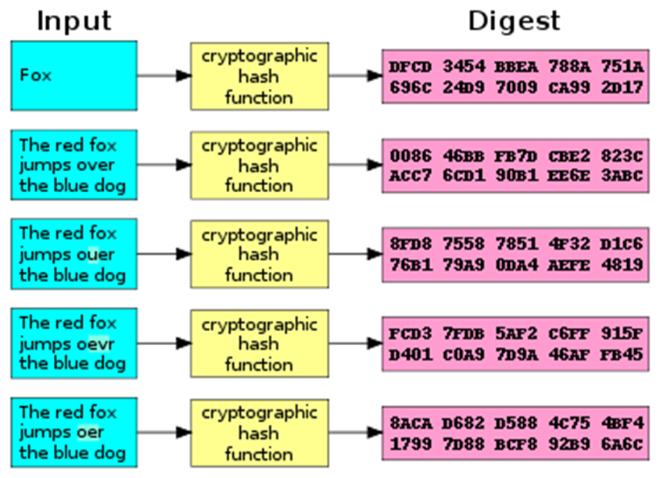
Hash Functions
A Hash Function is a mathematical function that maps data of arbitrary size to a fixed-size output.
In Blockchain, Hash Functions are used to provide a unique and tamper-proof digital fingerprint of data.
The SHA-256 (Secure Hash Algorithm 256-bit) is commonly used Hash Function in Blockchain.
In Blockchain, Hash Functions are used to create the Hash of each block's data, which includes transactions, timestamp, and a reference to the previous block's Hash.
The Hash of the current block is included in the next block, creating a chain of blocks that are linked together cryptographically.

Slide 4
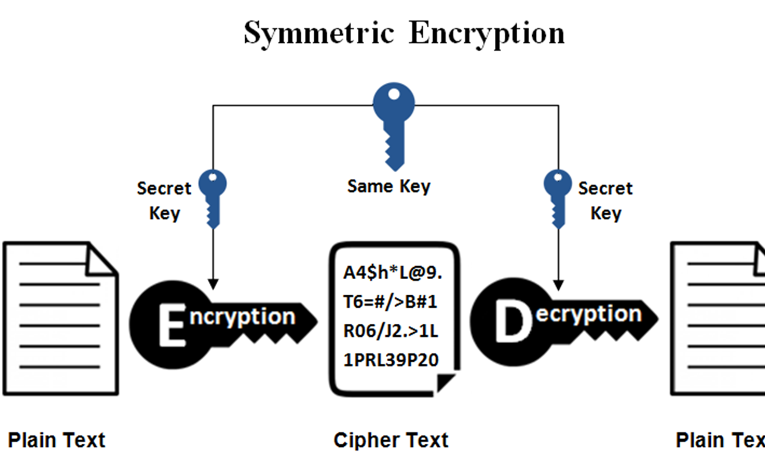
Symmetric Cryptography
Uses the same key for both encryption and decryption
Fast and efficient for bulk data encryption
Examples: AES, DES, Blowfish
Blockchain uses Symmetric Cryptography to secure communication between nodes
Transactions are encrypted with a shared secret key to maintain confidentiality
In the Bitcoin network, transactions are encrypted using the Advanced Encryption Standard (AES) with a 256-bit key

Slide 5
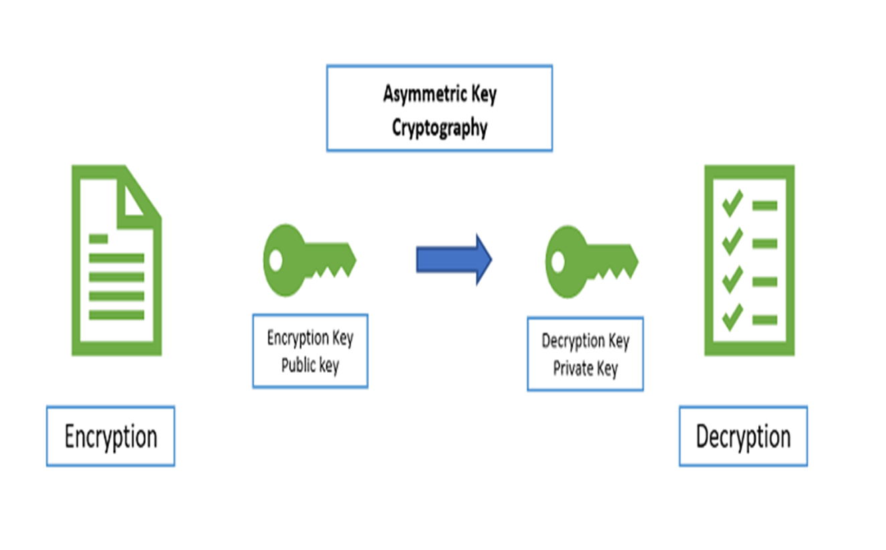
Public Key Cryptography
Public key cryptography is a type of asymmetric cryptography used in Blockchain.
It uses a pair of keys – a public key and a private key – for secure communication.
The public key is used for encryption and is available to anyone, while the private key is kept secret and used for decryption.
In Blockchain, public key cryptography is used for digital signatures.

Slide 6

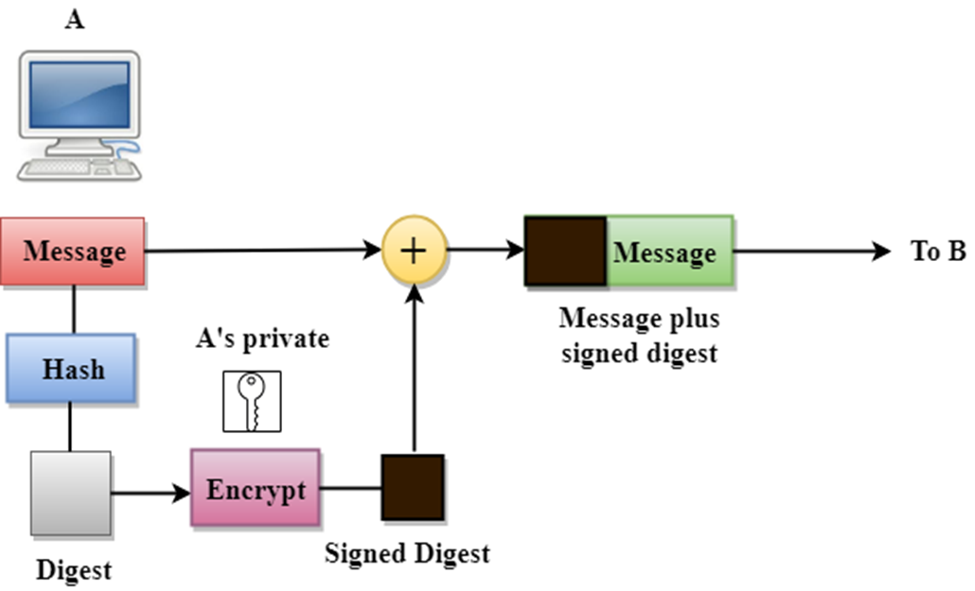
Digital Signatures Creation
Importance of digital signatures in ensuring security and authenticity in blockchain transactions
A digital signature is created using a private key and the message to be signed

Slide 7
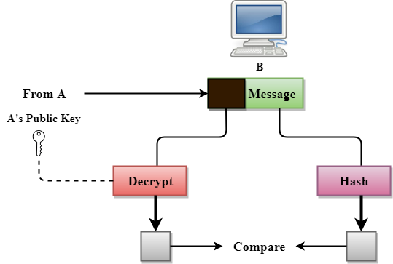
Digital Signature Verification
A digital signature is verified using the corresponding public key and the original message
The advantages of using digital signatures in blockchain, such as improved security, authenticity, and non-repudiation

Slide 8

Message Authentication & Digital SIgnature

Slide 9
Outline
Message authentication
MAC, HMAC, DAA, CMAC
Digital Signature
Digital Signature Requirements
RSA approach
DSA Signing and Verifying
Elgamal Fdigital SIgnature
Notes:
X.800 and RFC 2828
International Telecommunication Union (ITU)

Slide 10
1. Message Authentication
Message authentication is a mechanism or service used to verify the integrity of a message.
Message authentication assures that data received are exactly as sent (i.e., contain no modification, insertion, deletion, or replay).
When a hash function is used to provide message authentication, the hash function value is often referred to as a message digest.

Slide 11
Message authentication method - 1
Source A
Destination B
M
M
H
ll
E
D
Compare
K
K
H
H(M)
E (K, [ M || H(M)])
Only A and B share the secret key, the message must have come from A and has not been altered.
The hash code provides the structure required to achieve authentication.
Because encryption is applied to the entire message plus hash code, confidentiality is also provided.

Slide 12
Message authentication method - 2
Source A
Destination B
M
M
H
ll
K
K
Compare
H
E
D
E(K, H(M))
Only the hash code is encrypted, using symmetric encryption.
This reduces the processing burden for those applications that do not require confidentiality.

Slide 13
Message authentication method - 3
Source A
Destination B
M
M
S
ll
H
ll
Compare
S
ll
H
H(M || S)
It is possible to use a hash function but no encryption for message authentication.
A and B share a common secret value S.
A computes the hash value over the concatenation of M and S and appends the resulting hash value to M.
Because B possesses S, it can recompute the hash value to verify.
An opponent cannot modify an intercepted message.

Slide 14
Message authentication method - 4
Source A
Destination B
M
M
S
ll
H
ll
E
D
Compare
K
K
S
ll
H
H(M || S)
E (K, [ M || H(M || S)])
Confidentiality can be added to the approach of method (3) by encrypting the entire message plus the hash code.

Slide 15
MAC (Message Authentication Code)
More commonly, message authentication is achieved using a MAC also known as keyed hash function.
MACs are used between two parties that share a secret key to authenticate information exchanged between those parties.
A MAC function takes as input a secret key and a data block and produces a hash value, referred to as the MAC.
The combination of hashing and encryption results in an overall function that is, in fact, a MAC (Method -2 in previous slide).

Slide 16
Message Authentication Requirements
Disclosure
Traffic analysis
Masquerade
Content modification
Sequence modification
Timing modification
Source repudiation
Destination repudiation
Requires Message Confidentiality
Requires Message Authentication
Requires Digital Signature

Slide 17
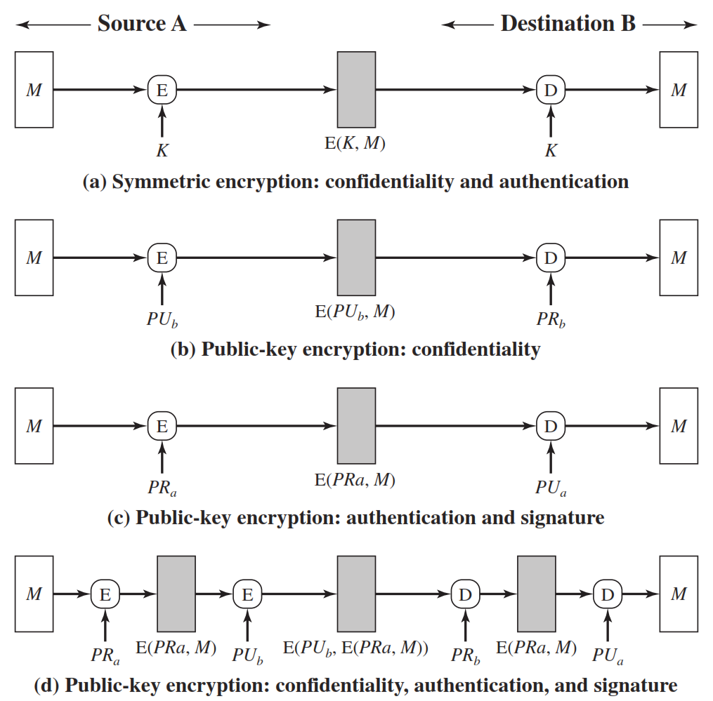

Slide 18
Message Authentication Code
An alternative authentication technique involves the use of a secret key to generate a small fixed-size block of data, known as a cryptographic checksum or MAC
MAC is appended to the message. This technique assumes that two communicating parties, say A and B, share a common secret key K.
When A has a message to send to B, it calculates the MAC as a function of the message and the key
MAC = C ( K , M )

Slide 19
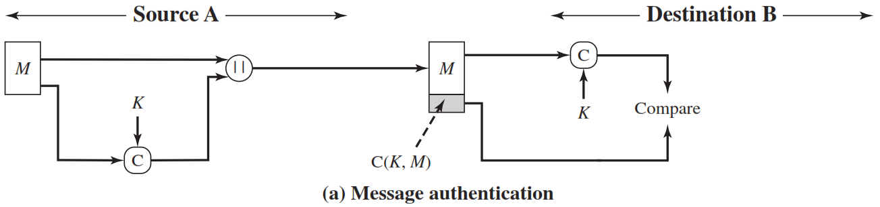
Message Authentication Code
The receiver is assured that the message has not been altered. If an attacker alters the message but does not alter the MAC, then the receiver’s calculation of the MAC will differ from the received MAC.
Because the attacker is assumed not to Know the secret key, the attacker cannot alter the MAC to correspond to the alterations in the message.

Slide 20
Message Authentication code - Cont…
The receiver is assured that the message is from the alleged sender.
Because no one else knows the secret key, no one else could prepare a message with a proper MAC.
A MAC function is similar to encryption. One difference is that the MAC algorithm need not be reversible, as it must be for decryption.
In general, the MAC function is a many-to-one function. The domain of the function consists of messages of some arbitrary length, whereas the range consists of all possible MACs and all possible keys.
If an n-bit MAC is used, then there are 2 ^{n} possible MACs

Slide 21
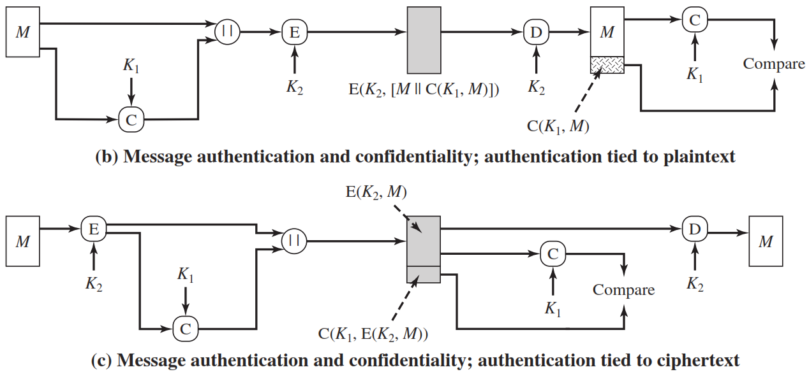
Message Authentication code - Cont…

Slide 22
MAC Based on Hash Functions - HMAC
Cryptographic hash functions such as MD5 and SHA generally execute faster in software than symmetric block ciphers such as DES.
Library code for cryptographic hash functions is widely available.

Slide 23
Design objectives for HMAC
To use, without modifications, available hash functions.
To allow for easy replaceability of the embedded hash function in case faster or more secure hash functions are found or required.
To preserve the original performance of the hash function without incurring a significant degradation.
To use and handle keys in a simple way.
To have a well understood cryptographic analysis of the strength of the authentication mechanism based on reasonable assumptions about the embedded hash function.

Slide 24
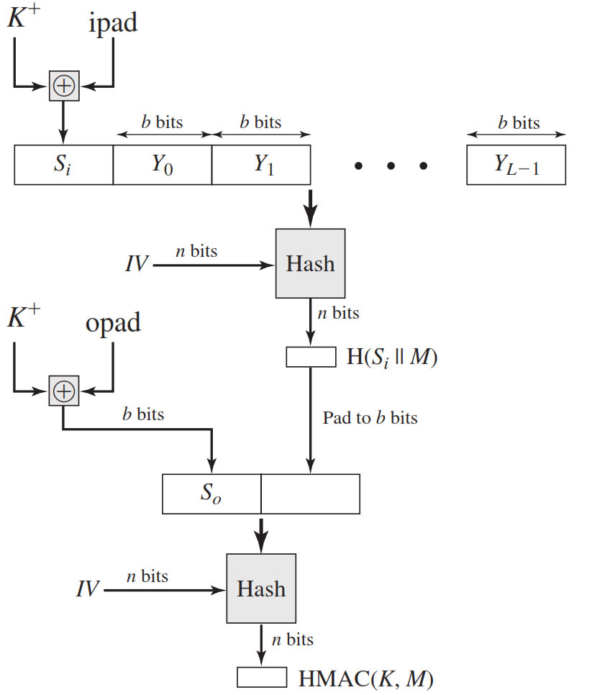
HMAC Structure
Append zeros to the left end of K to create a b-bit string K⁺
XOR K⁺ with ipad to produce the b-bit block Si.
Append M to Si.
Apply H to the stream generated in step 3.
XOR K⁺ with opad to produce the b-bit block S₀.
Append the hash result from step 4 to S₀.
Apply H to the stream generated in step 6 and output the result.

Slide 25
HMAC Structure
H = embedded hash function (e.g., MD5, SHA-1, RIPEMD-160)
IV = initial value input to hash function
M = message input to HMAC
Yi = i ^{th} block of M
L = number of blocks in M
n = length of hash code produced by embedded hash function
K ⁺ = K padded with zeros on the left so that the result is b bits in length
ipad = 00110110 (36 in hexadecimal) repeated b/8 times
opad = 01011100 (5C in hexadecimal) repeated b/8 times

Slide 26
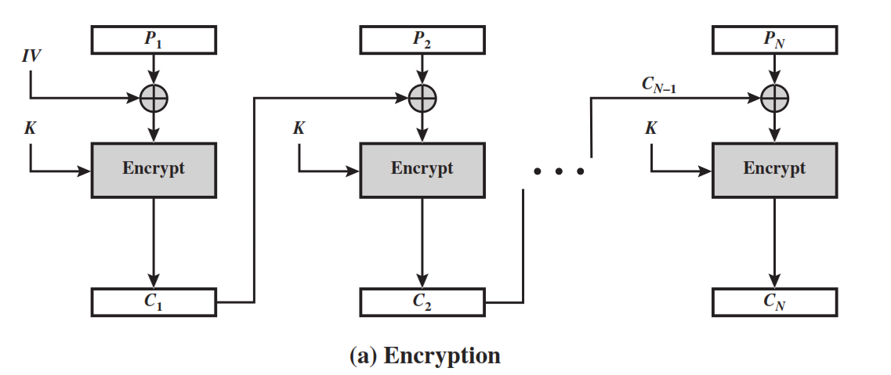
MAC based on Block Ciphers
The Data Authentication Algorithm (DAA), based on DES, has been one of the most widely used MACs for a number of years.
The algorithm can be defined as using the cipher block chaining (CBC) mode of operation of DES (Figure 6.4) with an initialization vector of zero.

Slide 27
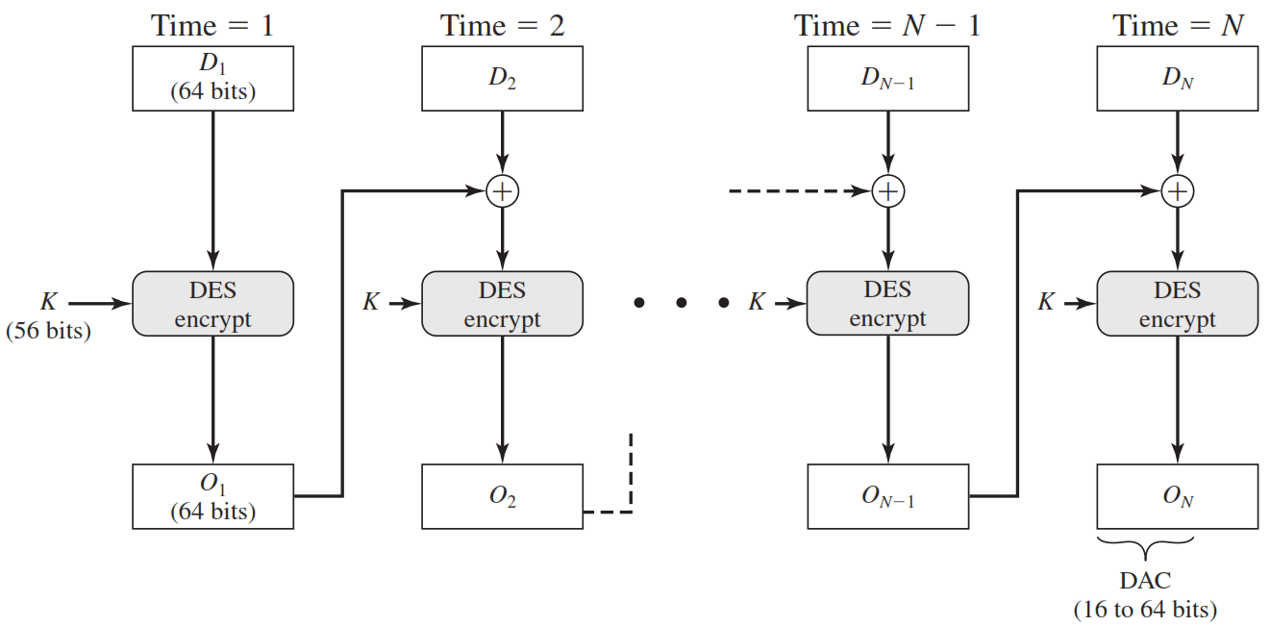
Data Authentication Algorithm (DAA)

Slide 28
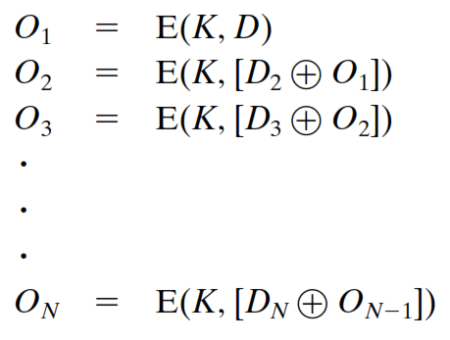
Data Authentication Algorithm (DAA)
The data (e.g., message, record, file, or program) to be authenticated are grouped into contiguous 64-bit blocks:
D1, D2, …. Dn. If necessary, the final block is padded on the right with zeroes to form a full 64-bit block. Using the DES encryption algorithm E and a secret key K, a data authentication code (DAC) is calculated as follows

Slide 29
Cipher-Based Message Authentication Code (CMAC)
Cipher-based Message Authentication Code (CMAC) mode of operation for use with AES and triple DES.
First, let us define the operation of CMAC when the message is an integer multiple n of the cipher block length b. For AES, b = 128, and for triple DES, b = 64. The message is divided into n blocks (M1, M2,… Mn)

Slide 30
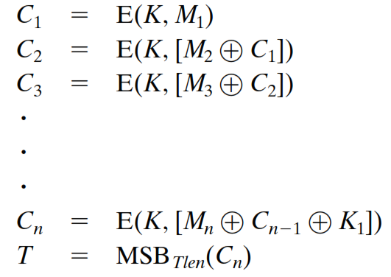
Cipher-Based Message Authentication Code (CMAC)
The algorithm makes use of a k-bit encryption key K and a b-bit constant, K1.
For AES, the key size k is 128, 192, or 256 bits; for triple DES, the key size is 112 or 168 bits.
CMAC is calculated as follows

Slide 31
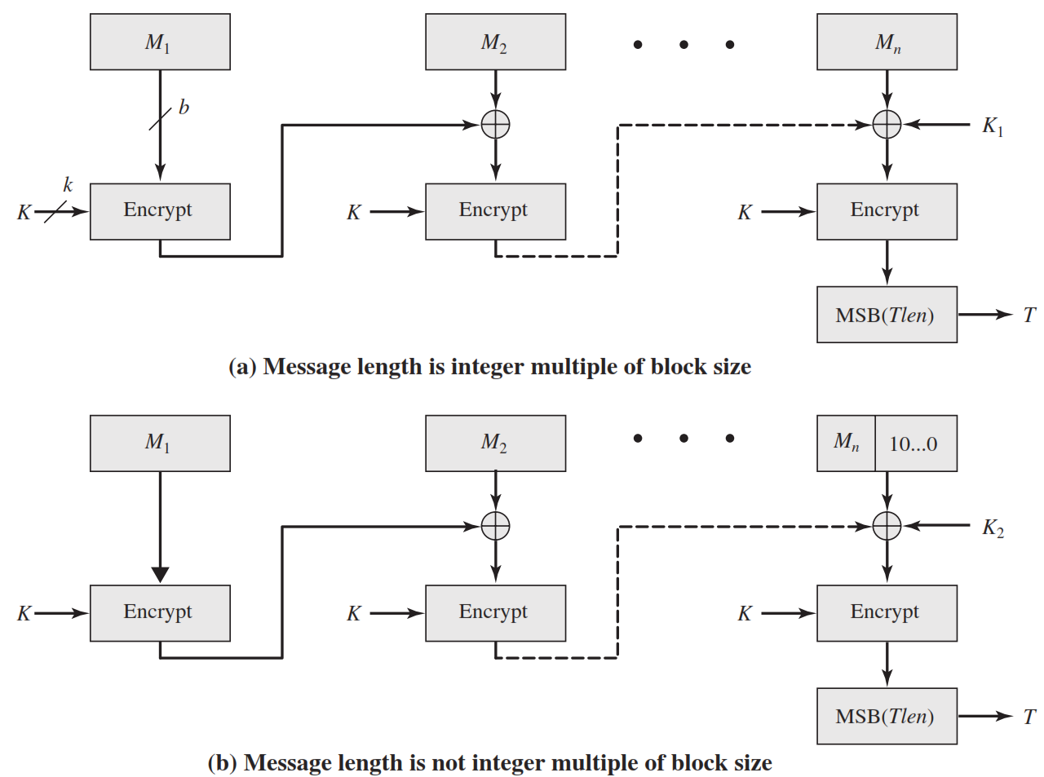
Cipher-Based Message Authentication Code (CMAC)

Slide 32
Digital Signature
A digital signature is an authentication mechanism that enables the creator of a message to attach a code that acts as a signature.
Typically the signature is formed by taking the hash of the message and encrypting the message with the creator’s private key.
The signature guarantees the source and integrity of the message.
The digital signature standard (DSS) is an NIST standard that uses the secure hash algorithm (SHA).

Slide 33
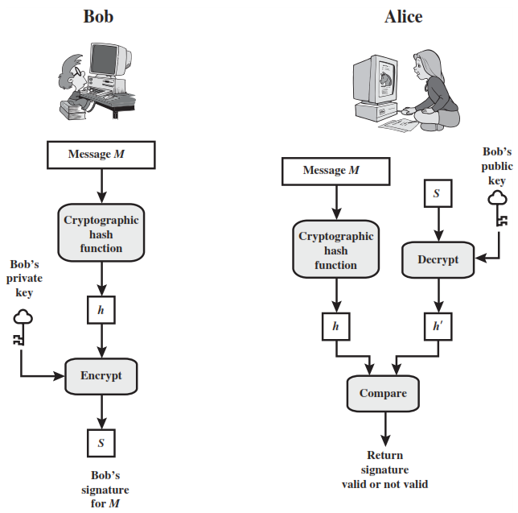

Slide 34
Digital Signature Requirements
The signature must be a bit pattern that depends on the message being signed.
The signature must use some information unique to the sender to prevent both forgery and denial.
It must be relatively easy to produce the digital signature.
It must be relatively easy to recognize and verify the digital signature.
It must be computationally infeasible to forge a digital signature, either by constructing a new message for an existing digital signature or by constructing a fraudulent digital signature for a given message.
It must be practical to retain a copy of the digital signature in storage.

Slide 35
Digital Signature Standard / DSA
The DSS uses an algorithm that is designed to provide only the digital signature function.
Unlike RSA, it cannot be used for encryption or key exchange.

Slide 36
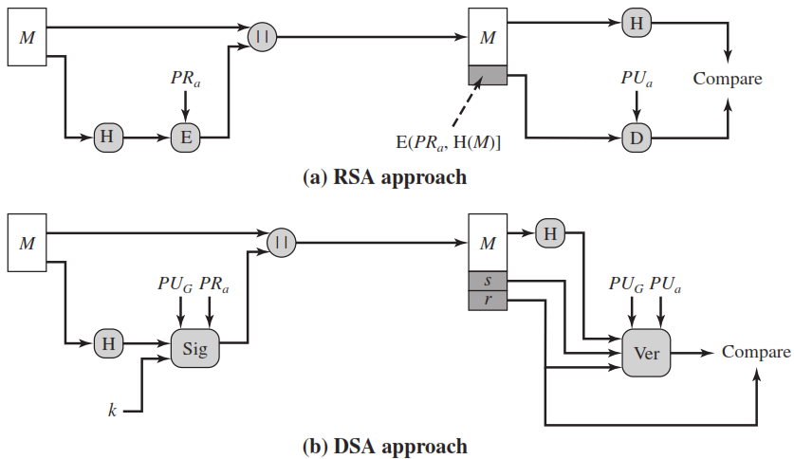
RSA Approach
In the RSA approach, the message to be signed is input to a hash function that produces a secure hash code of fixed length.
This hash code is then encrypted using the sender’s private key to form the signature.
Both the message and the signature are then transmitted.
The recipient takes the message and produces a hash code.

Slide 37
RSA Approach
The recipient also decrypts the signature using the sender’s public key.
If the calculated hash code matches the decrypted signature, the signature is accepted as valid.
Because only the sender knows the private key, only the sender could have produced a valid signature.

Slide 38
DSA Approach
The hash code is provided as input to a signature function along with a random number k generated for this particular signature.
The signature function also depends on the sender’s private key (PRa) and a set of parameters known to a group of communicating principals.
We can consider this set to constitute a global public key (PU)
The result is a signature consisting of two components, labelled s and r.

Slide 39
DSA Approach
At the receiving end, the hash code of the incoming message is generated.
This plus the signature is input to a verification function.
The verification function also depends on the global public key as well as the sender’s public key (PUa), which is paired with the sender’s private key.
The output of the verification function is a value that is equal to the signature component r if the signature is valid.
The signature function is such that only the sender, with knowledge of the private key, could have produced the valid signature.

Slide 40
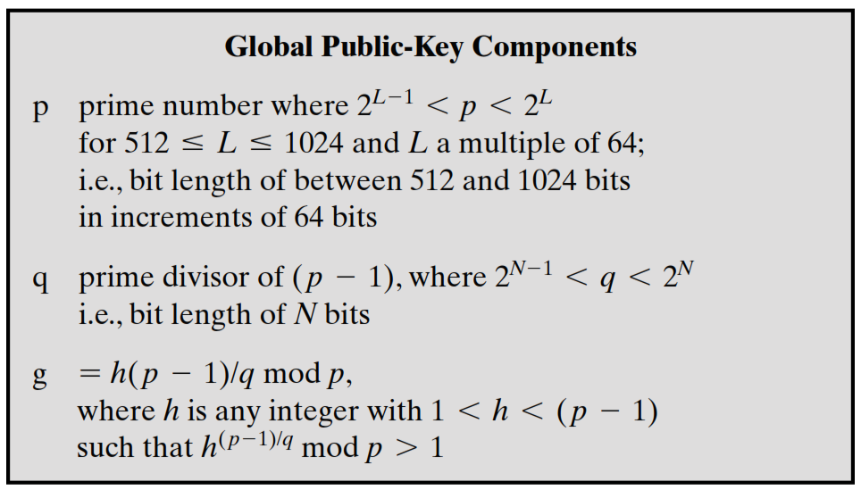
Digital Signature Algorithm

Slide 41
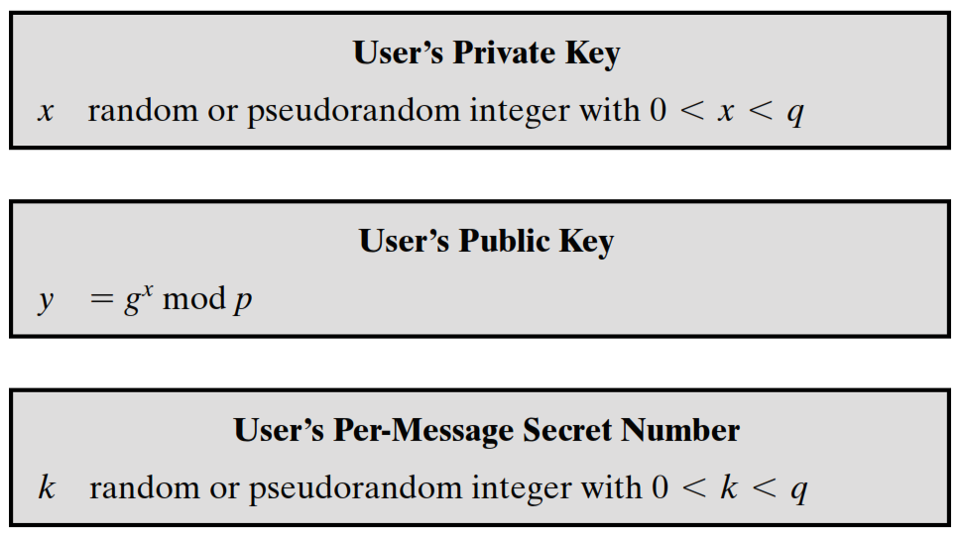
Digital Signature Algorithm

Slide 42
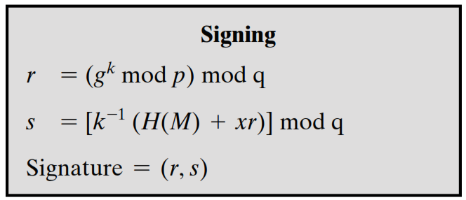
Digital Signature Algorithm

Slide 43
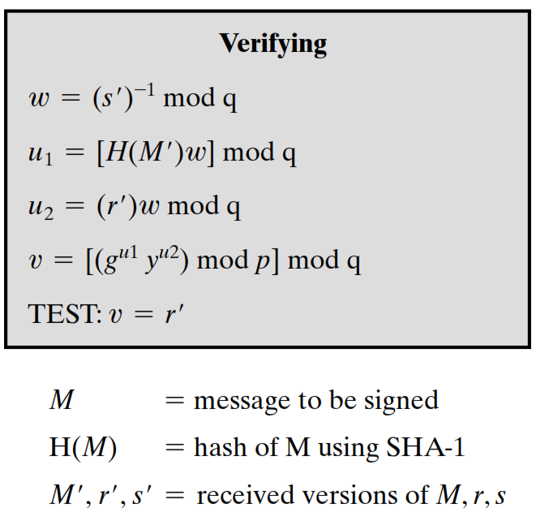
Digital Signature Algorithm

Slide 44
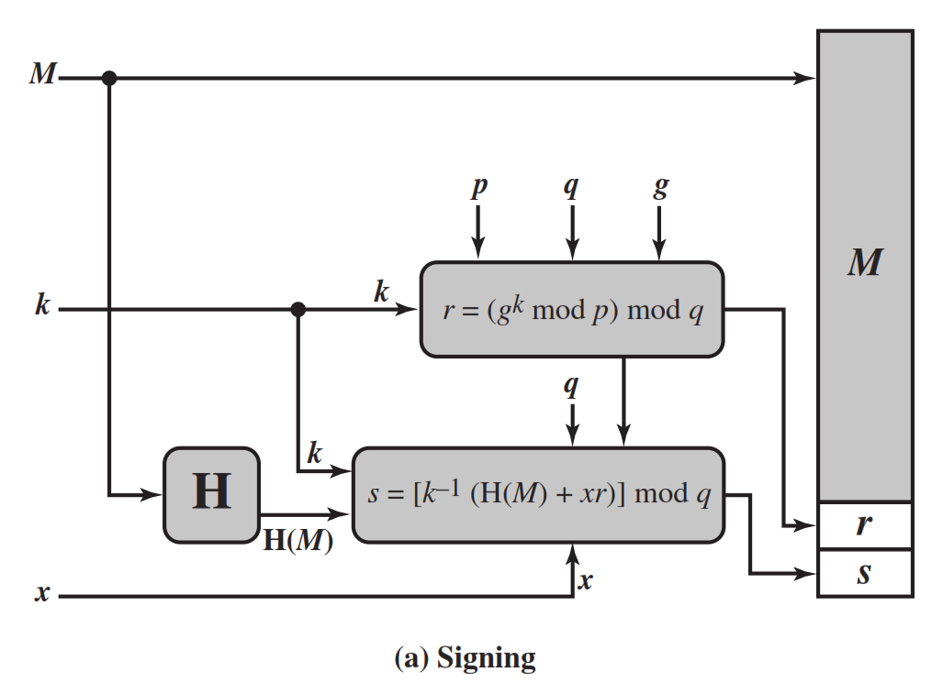
DSA Signing

Slide 45
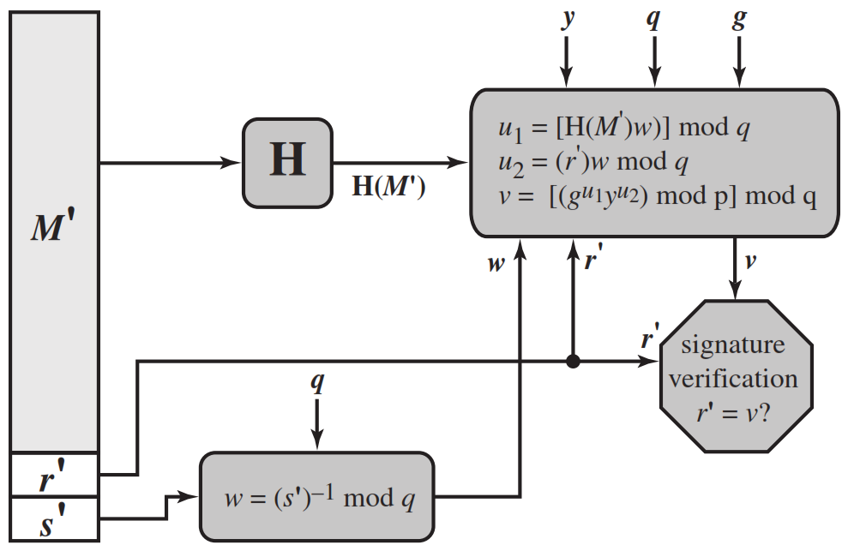
DSA Verifying

Slide 46
ElGamal Digital Signatures
Uses private key for encryption (signing)
Uses public key for decryption (verification)
Each user (eg. A) generates their key
chooses a secret key (number): 1 < x_{A} < q-1
compute their public key: y_{A} = a^{xA} mod q
Notes:
Recall from Chapter 10, that in 1984, T. Elgamal announced a public-key scheme based on discrete logarithms, closely related to the Diffie-Hellman technique [ELGA84, ELGA85]. The ElGamal encryption scheme is designed to enable encryption by a user's public key with decryption by the user's private key. The ElGamal signature scheme involves the use of the private key for encryption and the public key for decryption. The ElGamal cryptosystem is used in some form in a number of standards including the digital signature standard (DSS) and the S/MIME email standard. As with Diffie-Hellman, the global elements of ElGamal are a prime number q and a, which is a primitive root of q. User A generates a private/public key pair as shown. The security of ElGamal is based on the difficulty of computing discrete logarithms, to recover either x given y, or k given K (next slide).

Slide 47
ElGamal Digital Signature
Alice signs a message M to Bob by computing
the hash m = H(M), 0 <= m <= (q-1)
chose random integer K with 1 <= K <= (q-1) and gcd(K,q-1)=1
compute temporary key: S₁ = a^{k} mod q
compute K⁻¹ the inverse of K mod (q-1)
compute the value: S₂ = K⁻¹(m-x_{A}S₁) mod (q-1)
signature is:(S₁,S₂)
Any user B can verify the signature by computing
V₁ = a^{m} mod q
V₂ = y_{A}^{S1} S₁^{S2} mod q
Signature is valid if V₁ = V₂
Notes:
To sign a message M, user A first computes the hash m = H(M), such that m is an integer in the range 0 <= m <= q – 1. A then forms a digital signature as shown.
The basic idea with El Gamal signatures is to again choose a temporary random signing key, protect it, then use it solve the specified equation on the hash of the message to create the signature (in 2 pieces). Verification consists of confirming the validation equation that relates the signature to the (hash of the) message (see text for proof). Again note that El Gamal encryption involves 1 modulo exponentiation and multiplications (vs 1 exponentiation for RSA).

Slide 48
ElGamal Signature Example
Use field GF(19) q=19 and a=10
Alice computes her key:
A chooses x_{A}=16 & computes y_{A}=10¹⁶ mod 19 = 4
Alice signs message with hash m=14 as (3,4):
choosing random K=5 which has gcd(18,5)=1
computing S₁ = 10⁵ mod 19 = 3
finding K⁻¹ mod (q-1) = 5⁻¹ mod 18 = 11
computing S₂ = 11(14-16.3) mod 18 = 4
Any user B can verify the signature by computing
V₁ = 10¹⁴ mod 19 = 16
V₂ = 4³.3⁴ = 5184 = 16 mod 19
since 16 = 16 signature is valid
Notes:
Here is an example of creating and verifying an ElGamal signature from the text using the prime field GF(19); that is, q = 19. It has primitive roots {2, 3, 10, 13, 14, 15}, as shown in Table 8.3. We choose a = 10. Alice generates a key pair as shown, which is = {19, 10, 4}. Alice can sign a message with hash m = 14 as shown to compute the signature pair (3,4). Any user B can verify the signature by computing confirming the validation equation as shown.

